Slide 1


text2sum
AuTOMATED text SUMMARIZATION USING NLP AND LLM
MUTHUKUMAR S
30.08.24

Slide 2


Table Of Contents
Introduction
THE TRANSFORMER ARCHITECTURE
THE TASK
THE DATASET
EVALUATION METRICS
tERM CORRElation
TRAINING & MODEL BUILDING
FINE TUNING
DEPLOYMENT
11.07.2023

Slide 3

Introduction
11.07.2023

Slide 4

TEXT SUMMARIZATION
Text summarization is the process of condensing a large body of text into a shorter version, retaining its key ideas and essential information.
As the volume of digital content grows exponentially, the need for efficient text summarization techniques has become critical in various fields, from journalism and academic research to business and artificial intelligence.
This presentation explores the fundamentals of text summarization, its types, techniques, and applications, highlighting its importance in the modern digital age.
11.07.2023

Slide 5
TYPES OF SUMMARIZATION
Extractive Summarization
Definition: Involves selecting and extracting key sentences or phrases directly from the original text.
Approach: Focuses on identifying the most important parts of the text without altering the original content.
Example: Highlighting the key sentences in a news article.
Abstractive Summarization
Definition: Involves generating new sentences that capture the essence of the original text.
Approach: Uses natural language processing (NLP) and machine learning to understand and rephrase the content.
Example: Summarizing a lengthy report into a concise paragraph using a neural network model.
11.07.2023

Slide 6

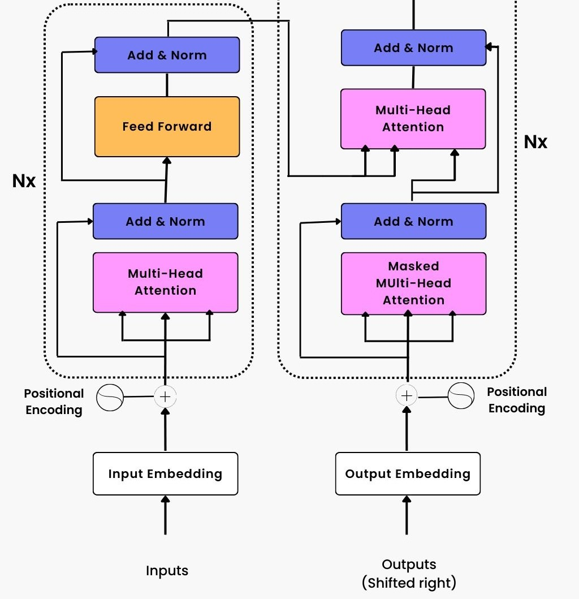
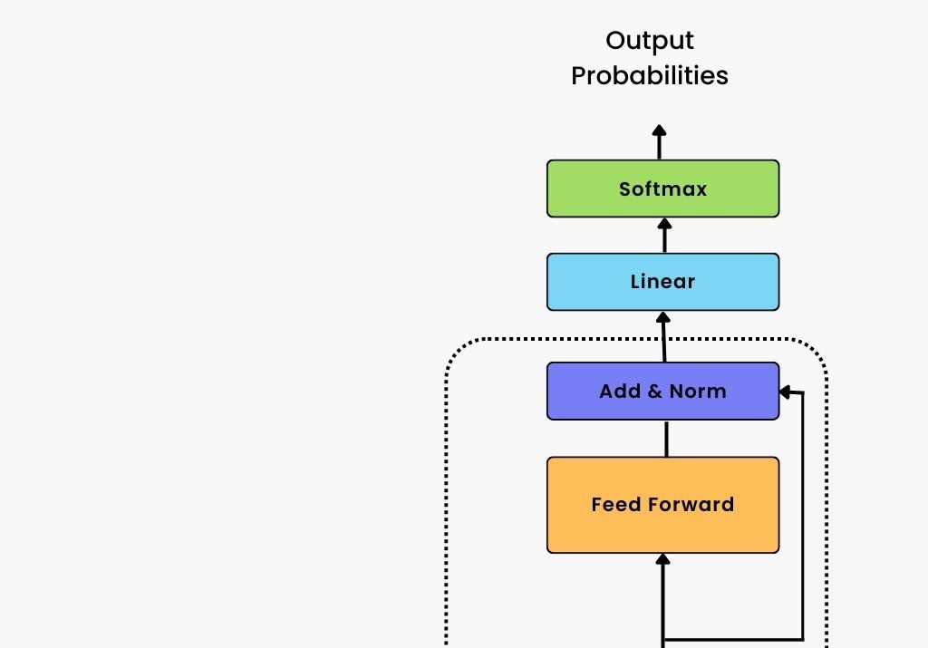

TRANSFORMER ARCHITECTURE
.
11.07.2023

Slide 7
ARCHITECTURE
The transformer architecture, is based on the attention mechanism, which allows the model to process an entire sentence or paragraph at once, rather than each word at a time.
The processing of text input with the transformer architecture is based on tokenization, which is the process of transforming texts into smaller components called tokens.
The tokens are then mapped to numerical IDs, which are unique for each word or subword. Each ID is then transformed into an embedding.
It is important to note that these embeddings are high-dimensional, with each dimension capturing certain aspects of a token’s meaning.
Due to their high-dimensional nature, embeddings are not easily interpreted by humans, but transformer models readily use them to identify and group together tokens with similar meanings in the vector space.
11.07.2023

Slide 8

THE TASK AND
THE DATASET
11.07.2023

Slide 9
THE GOAL
The goal of this project is to demonstrate how Large Language Models can be used for several tasks related to language processing.
In this case, I am going to leverage the power of transfer learning to build a model capable of summarizing dialogues.
Transfer learning is a machine learning technique in which we use a pre-trained model—that is already knowledgeable in a wide domain—and tailor its expertise for a specific task by training it in a specific dataset we might have. This process may also be referred to as fine-tuning.
11.07.2023

Slide 10
THE TASK
The task at hand is Text Summarization.
From the documentation of the 🤗 Transformers library, summarization can be described as the creation of a shorter version of a document or an article that captures all the important information.
In this case, we are going to summarize dialogues by using a dataset containing chat texts.
11.07.2023

Slide 11
THE DATASET
Overview: The SamSum dataset is specifically designed for training and evaluating models in the task of dialogue summarization. It contains thousands of annotated conversations, primarily focused on summarizing informal dialogues.
Dataset Composition:
Conversations: 16,369 unique dialogues written in English, with a wide variety of topics, including daily life, planning, and social interactions.
Summaries: Each dialogue is accompanied by a manually written summary that captures the main points and key information.
A SPECIFIC ID , DIALOGUE AND SUMMARY
Key Features:
Realistic Dialogues: The conversations are designed to mimic real-world, informal communication styles, such as those found in messaging apps.
Abstractive Summaries: The provided summaries are often abstractive, meaning they rephrase and condense the dialogues rather than just extracting parts of the conversation.
11.07.2023

Slide 12
THE DATASET
Training Set:
Size: 14,732 dialogues
Purpose: Used to train models and adjust parameters for dialogue summarization.
Validation Set:
Size: 816 dialogues
Purpose: Used to tune hyperparameters and prevent overfitting during model training.
Test Set:
Size: 1006 dialogues
Purpose: Used to evaluate the final model’s performance and ensure generalization to unseen data.
11.07.2023

Slide 13
EVALUATION METRICS
ROGUE l
ROGUE S
Captures the Longest Common Subsequence (LCS) between summaries, reflecting content coverage.
Evaluates skip-bigrams, which allow gaps between words, to measure coherence.
ROGUE - 1 2 3
Measure overlap of unigrams, bigrams, and trigrams respectively, to evaluate similarity.
Score Range: Typically between 0 (no match) and 50 (perfect match).
Human Evaluation: Complements quantitative metrics by leveraging human understanding to assess summary accuracy and relevance.
11.07.2023

Slide 14


MODEL AND
PRE-PROCESSING
11.07.2023

Slide 15
DATA CLEANING AND ANALYSIS
Null Entries:
Removed sample 6054 due to a Null dialogue with an uninformative summary.
Length Analysis:
Dialogues: Average 94 words, with some extending over 300 words.
Summaries: Average 20 words, with some longer outliers.
TF-IDF Vectorization:
Used scikit-learn's TfidfVectorizer to extract the most frequent terms (unigrams, bigrams, trigrams) in dialogues and summaries.
Filtered out common stop-words to focus on relevant terms.
11.07.2023

Slide 16
TERM CORRELATION ANALYSIS
Heatmap Insights:
Analyzed term correlations in dialogues and summaries.
Weak correlations overall, with the most positive pair being "don" and "know" at 0.12.
Observed a slight negative correlation between "yes" and "yeah"..
Summary Correlations:
Stronger correlations in summaries than in dialogues.
Common correlated pairs: "going" and "meet", "come" and "party".
Summaries show a consistent pattern, especially with time-related terms like "15 minutes"
11.07.2023

Slide 17
DATA PREPARATION
Tag Removal:
Cleaned text data by removing tags like "file_photo" using the clean_tags function.
Ensured a cleaner dataset for better model performance.
Data Preparation:
Converted Pandas DataFrames to Hugging Face Datasets using the Datasets library.
Removed unnecessary columns like __index_level_ .
Prepared data for input into pre-trained models like BART for fine-tuning.
11.07.2023

Slide 18
FINE TUNING AND
DEPLOYMENT
11.07.2023

Slide 19
FINETUNING BART FOR SUMMARIZATIONMODEL
Model Selection:
We are fine-tuning facebook/bart-large-xsum, originally trained on news articles, to better handle dialogue data using the SAMSum dataset.
Model Demonstration:
Example: Summarized an unseen CNN news article, showing BART's effectiveness in condensing relevant information.
Need for Fine-Tuning:
The model's training on news datasets necessitates fine-tuning for dialogue data to improve performance on conversation summaries.
11.07.2023
Tag Removal:
Cleaned text data by removing tags like "file_photo" using the clean_tags function.
Ensured a cleaner dataset for better model performance.
Data Preparation:
Converted Pandas DataFrames to Hugging Face Datasets using the Datasets library.
Removed unnecessary columns like __index_level_ .
Prepared data for input into pre-trained models like BART for fine-tuning.

Slide 20
PRE-PROCESSING AND TOKENIZATION
Preprocessing Steps:
Removed unnecessary tags and cleaned the dataset to enhance model performance.
Tokenization:
Used BartTokenizer to convert dialogues into tokens (input_ids) and applied attention masks to focus on relevant tokens.
Labels for training were also tokenized with a focus on shorter text lengths (128 tokens for summaries).
Features Explained:
input_ids: Tokenized words or subwords.
attention_mask: Indicates relevant tokens.
labels: Token IDs for summaries.
11.07.2023
Tag Removal:

Slide 21
TRAINING AND EVALUATION
Training Process:
Used Seq2SeqTrainer with 4 epochs, selecting the best model based on Validation Loss and ROUGE scores.
Best performance achieved through epochs are 47 (50) and 48 (50)respectively with the lowest Validation Loss and highest ROUGE scores.
Evaluation:
Model showed higher performance on the validation set compared to the testing set, with concise and informative summaries.
Saving and Sharing:
The fine-tuned model is saved and available on Hugging Face as bart-finetuned-samsum.
Ready for generating summaries for human evaluation and application to new datasets.
11.07.2023

Slide 22


CONCLUSION
Model Performance:
Successfully fine-tuned BART for text or document summarization.
Key Takeaways:
Effective preprocessing and tokenization are crucial.
Model performs well on dialogue summarization tasks.
Next Steps:
Further fine-tuning and model evaluation.
Deployment for real-time applications with Streamlit.
11.07.2023

Slide 23
THANK YOU SIR
11.07.2023

